Slide 1
Chapter 3 Core Java APIs
PRESENTED BY JALAL ASSALY

Slide 2
What is an API ?
API stands for Application Programming Interface.
A collection of classes or interfaces to a service or functionality within the JDK.

Slide 3
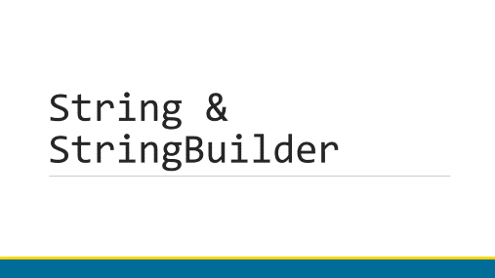
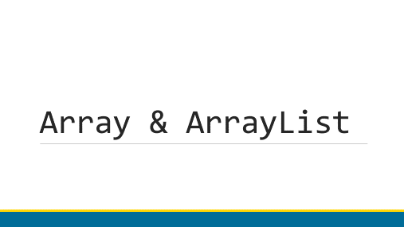

Core Java APIs

Slide 4
String & StringBuilder

Slide 5
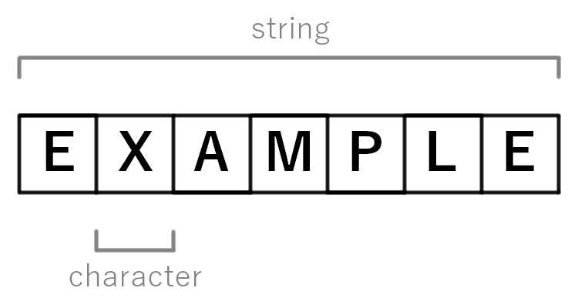
String API
The String class is a fundamental API used in almost every Java program.
A string is only a sequence of characters, such as:
String name = “Fluffy”;

Slide 6
String Concatenation
Concatenation in Java, is the process of combining two String Objects into one.
Examples
“1” + “2” = “12”
“23” + 1 + 45 = “23145”
Note that the + operator can be used in two ways, whether for regular integer addition, or for string concatenation. But which is it ?

Slide 7
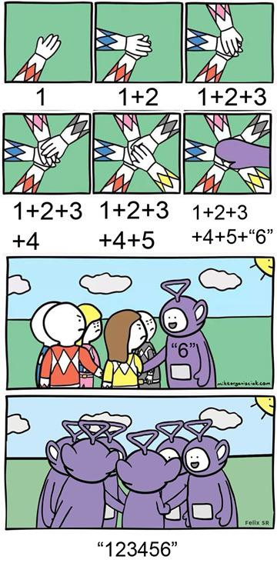
String Concatenation rules
There are three rules:
If all operands are numeric, + means a numeric addition.
If either operand is a String, + means concatenation.
The expression is evaluated left to right.
example = 1 + 2 + 3 + 4 + 5 + “6”
“156”

Slide 8
String Immutability
Once a String object is created, it is not allowed to change !
You cannot…
Add a character;
Delete a character;
Replace a character;
But you can…
Create a new String object using existing ones.
String s1 = “1”; // 1
String s2 = s1 + “2”; // 12
s1 = s1 + “3”; // 13
s2 = s1.concat(“4”) // 134
Note that every operation need to be caught in a reference variable.

Slide 9
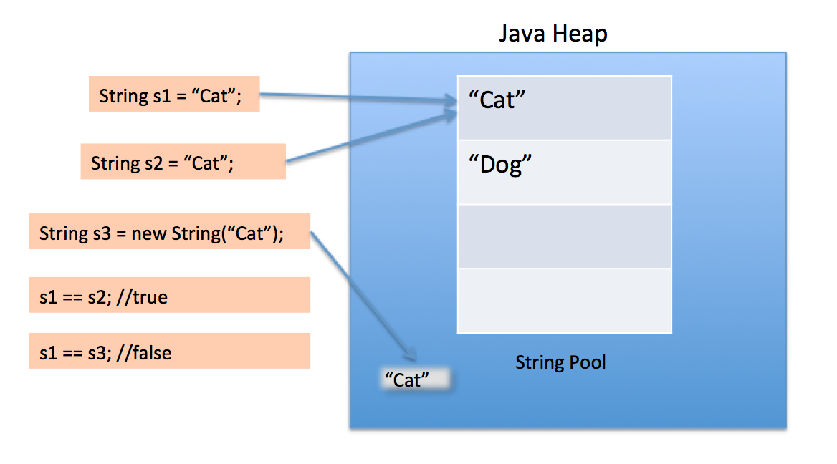
The String Pool
*
In Java, Strings are everywhere !
Can use up to 40% of the memory.
Key element: Strings often repeat in a program.
Solution: Reuse the common ones
How: Using the String Pool.

Slide 10
String Methods
*
The String class has many useful built-in methods. Here are a few:
int length(): returns the number of characters in the String.
char charAt(int index): returns the character at the queried index in a String.
int indexOf(char c): returns the index of the queried character’s first occurrence in a String.
String substring(int b, int e): returns a String slice from within a larger String variable.
boolean equals(String str): checks if the characters in two String objects are identical.
Notes:
Code

Slide 11
Sample Program
*
String alpha = “”;
for(char current = ‘a’; current <= ‘z’; current++) {
alpha += current; // alpha = alpha + current
}
System.out.println(alpha);
Heap
Notice any problem ?
Memory Consumption is huge !
“a”
“ab”
“abc”
All eligible for garbage collection !!
“abcd”
“abcde”
“abcdef”
…
A total of 27 objects are instantiated. Only one is kept

Slide 12
StringBuilder API
*
A StringBuilder is a mutable object that constructs/builds a String value.
StringBuilder alpha = new StringBuilder();
for(char current = ‘a’; current <= ‘z’; current++) {
alpha.append(current);
}
System.out.println(alpha);
The same StringBuilder object is reused without the need to create intermediate Strings each time.

Slide 13
StringBuilder Methods
Category 1
Methods returning a primitive or an object:
charAt(): returns a character
indexOf(): returns an integer
length(): returns an integer
substring(): returns a String
toString(): returns a String
Category 2
Methods performing an operation and returning a reference to the current StringBuilder:
append(): adds a String to the builder.
insert(): inserts a String at a given index.
delete(): deletes subpart of the builder.
reverse(): reverses the order of the builder.

Slide 14
Understanding Equality
*
So we understood that using “==” with objects and primitives works differently.
Let’s see how to use “==” with StringBuilders.
StringBuilder one = new StringBuilder();
StringBuilder two = new StringBuilder();
StringBuilder three = one.append(“a”);
System.out.println(one==two); // false
System.out.println(one==three); // true
Point to the same object in memory

Slide 15
Understanding Equality
*
So we understood that using “==” with objects and primitives works differently.
Let’s see how to use “==” with Strings.
String x = “Hello World”;
String y = “Hello World”;
System.out.println(x==y);
String x = “Hello World”;
String z = “ Hello World”.trim();
System.out.println(x==z);
// true (why ?)
// false (why ?)
Because literals are stored in the String Pool. JVM only stores one literal in memory.
Because z is computed at runtime. Since it is not the same at compile, a new String object is created.

Slide 16
Understanding Equality
*
You should never use “==” when comparing String objects !!
Instead, use .equals() method to compare the logical values.
Note that StringBuilder does not have a .equals() implementation.
To compare the content of two StringBuilders, we need to use .toString() and then the .equals().
String x = “Hello World”;
String z = “ Hello World”.trim();
System.out.println(x.equals(z)); // true

Slide 17
Array & ArrayList

Slide 18
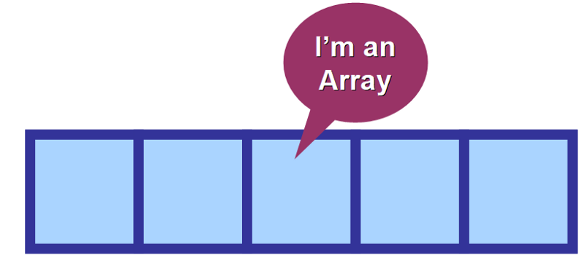
Arrays
An array is a an area of memory on the heap with space for a designated number of elements.
String and StringBuilder use the array structure.
Arrays can store any Java type !

Slide 19
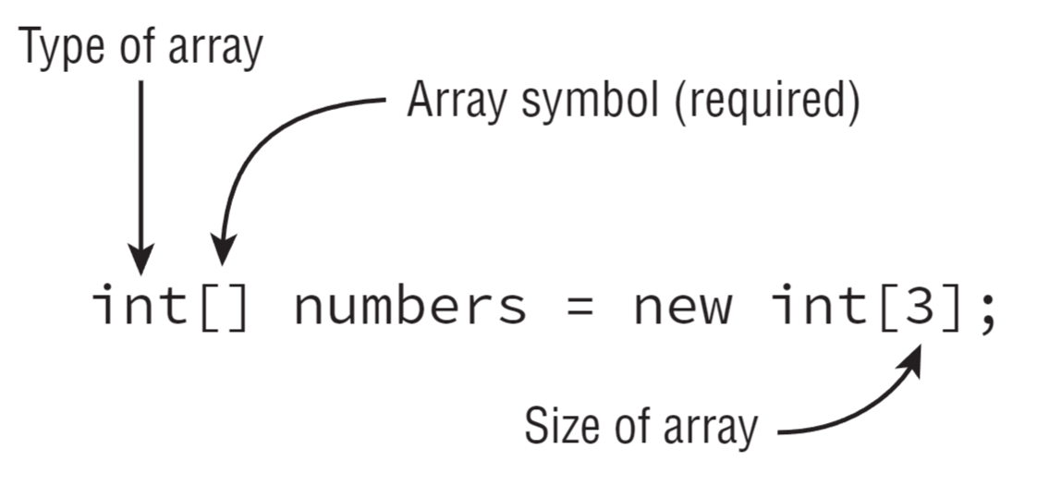
Array of Primitives
The most common way to create an array looks like this:
int[] numbers1 = new int[3];
“An array of integers reserved three spaces in the memory”.
The default value of the primitive type is stored initially. For integers, it’s 0.

Slide 20
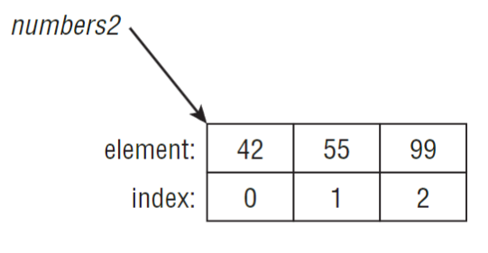
Array of Primitives
Other ways of making an array are:
int[] numbers2 = new int[] {42, 55, 99};
int[] numbers2 = {42, 55, 99};
“An array of integers reserved three spaces in the memory that contain 42, 55 and 99”.
Remember: an array is an object, so numbers2 is a reference to it.
Notice the index starting from 0

Slide 21
Side Note: []
The position of the [] can sometimes drastically impact the code behavior.
No Change Change
int[] numAnimals;
int [] numAnimals2;
int numAnimals3[];
int numAnimals4 [];
All make a reference to an integer array.
int[] ids, types; // two arrays of int
int ids[], types; // one array and one int
Two variables are declared at the same time, but [] position changed the behavior.

Slide 22
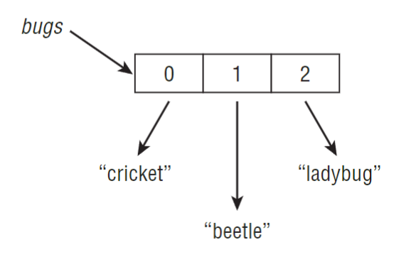
Array of Reference Variables
String[] bugs = {"cricket", "beetle", "ladybug"};
String[] alias = bugs;
System.out.println(bugs.equals(alias)); // true
Since array is an object, it implements .equals() and returns reference equality.

Slide 23
Using an Array
Accessing an Array: String[] mammals = {“monkey”, “chimp”, “donkey”};
System.out.println(mammals[0]); // monkey
System.out.println(mammals[1]); // chimp
Reading: int[] numbers = {6, 9, 1};
for(int i = 0; i < numbers.length; i++) { System.out.println(numbers[i]+“ ”); }
Writing: int[] numbers = new int[10];
for(int i = 0; i < numbers.length; i++) { numbers[i] = i+5; }

Slide 24
Sorting Arrays
Sorting: import java.util.Arrays
int[] numbers = {6, 9, 1};
Arrays.sort(numbers);
for(int i = 0; i < numbers.length; i++) { System.out.println(numbers[i]+“ ”); }
String[] strings = {“10”, “9”, “100”};
Arrays.sort(strings);
for(int i = 0; i < numbers.length; i++) { System.out.println(numbers[i]+“ ”); }
Result: 1 6 9
Result: 10 100 9

Slide 25
Searching Arrays
Searching must be operated on sorted arrays !!!
Searching: import java.util.Arrays
int[] numbers = {2, 4, 6, 8};
System.out.println(Arrays.binarySearch(numbers, 2)); // 0
System.out.println(Arrays.binarySearch(numbers, 4)); // 1
System.out.println(Arrays.binarySearch(numbers, 1)); // -1
System.out.println(Arrays.binarySearch(numbers, 3)); // -2
System.out.println(Arrays.binarySearch(numbers, 9)); // -5
If element is not found, binarySearch can still determine the position where element should be located.
Equation: -(returned_value + 1)

Slide 26
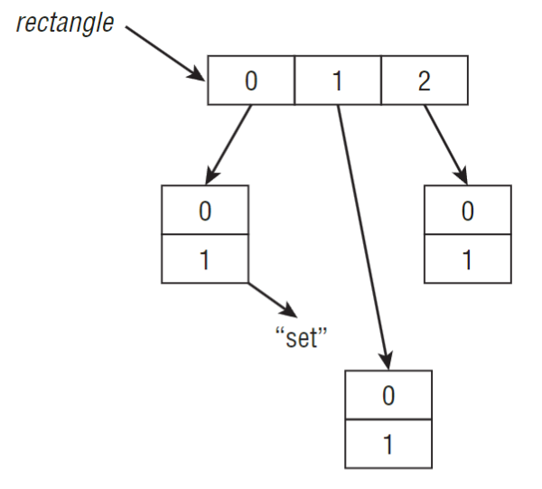
Multidimensional Arrays
Creation: int[][] vars1; // 2D array
int vars2 [][]; // 2D array
int[] vars3[]; // 2D array
int[] vars4[], space[][]; // a 2D AND a 3D array
Accessing: String [][] rectangle = new String[3][2];
rectangle[0][1] = “set”;
Note that rectangle is an array of arrays each containing references to String values.
Pay close attention to the brackets position !!

Slide 27
Multidimensional Array
Reading/Writing:
int[][] twoD = new int[3][2];
for (int i = 0; i< twoD.length; i++) {
for (int j = 0; j < twoD[i].length; j++)
{ System.out.println(twoD[i][j] + “ ”); }
System.out.println(); // new row
}
Enhanced:
for (int[] inner : twoD) {
for (int num : inner)
{ System.out.println(twoD[i][j] + “ ”); }
System.out.println(); // new row
}

Slide 28
ArrayList
Arrays have two problems:
Must know the size of an array when created;
Once created, its size cannot change.
Just like StringBuilder, ArrayList fixes those problems for arrays.
ArrayList is a mutable ordered sequence that allows duplicates.
To make an ArrayList, simply use:
ArrayList<T> list1 = new ArrayList<>();
List<T> list2 = new ArrayList<>();
ArrayList<T> list3 = new List<>(); // ILLEGAL
Does not compile, because List is an interface and cannot be instantiated

Slide 29
ArrayList.add()
Method Signature:
boolean add(E element)
void add(int index, E element)
Function: inserts a new value in the ArrayList
Examples:
ArrayList<Object> list = new ArrayList<>(); List<String> birds = new ArrayList<>();
list.add(“hawk”); // [hawk] birds.add(“hawk”); // [hawk]
list.add(Boolean.TRUE); // [hawk, true] birds.add(1, “robin”); // [hawk, robin]
birds.add(0, “cardinal”); // [cardinal, hawk, robin]
Note that in the first example, the type was not specified. Hence, all Objects can be legally added to the list.
E means Object if the ArrayList type was not defined, or it means the type itself if defined.

Slide 30
ArrayList.remove()
Method Signature:
boolean remove(Object object)
E remove(int index)
Function: removes the first matching value int the ArrayList, or removes the element at specified index.
Example:
List<String> birds = new ArrayList<>();
birds.add(“hawk”); // [hawk]
birds.add(“hawk”); // [hawk, hawk]
System.out.println(birds.remove(“cardinal”)); // prints false
System.out.println(birds.remove(“hawk”)); // prints true
System.out.println(birds.remove(0)); // prints hawk

Slide 31
ArrayList.equals()
Method Signature:
boolean equals(Object object)
Function: ArrayList implements its own equals function and can compare the elements inside and their order.
Example:
List<String> one = new ArrayList<>(); one.add(0, “b”); // [b, a]
List<String> two = new ArrayList<>(); two.add(1, “b”); // [a, b]
System.out.println(one.equals(two)); // true System.out.println(one.equals(two)); // false
one.add(“a”); // [a]
two.add(“a”); // [a]
System.out.println(one.equals(two)); // true
The order is important !

Slide 32
Sorting an ArrayList
There is no built-in method sort() inside of ArrayList, rather it is in the Collections class.
Notice that Collections is different from the Collection interface ! It is a helper class that provides useful manipulation functions
List<String> letters = new ArrayList<>();
letters.add(“B”);
letters.add(“C”);
letters.add(“A”);
Collections.sort(letters);
System.out.println(letters); // [A, B, C]

Slide 33
Wrapper Classes
Until now, only Objects were added to the ArrayList.
What happens if we want to add primitives in the ArrayList ? Does this work ?
ArrayList<int> list = new ArrayList<>();
Solution: Wrapper classes !
// (Illegal !)

Slide 34
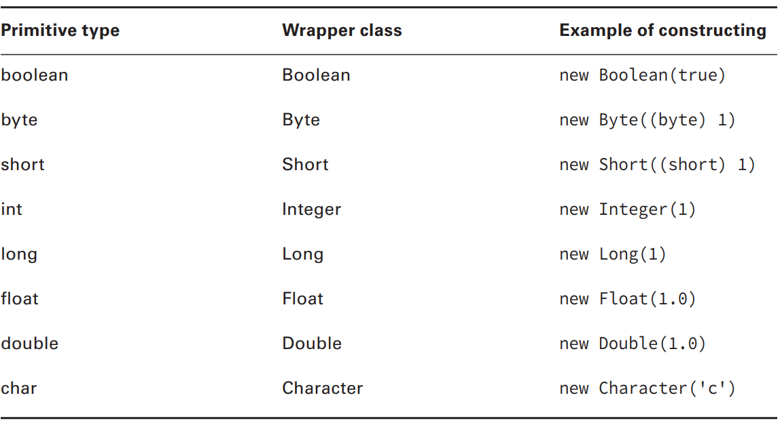
Wrapper Classes
A Wrapper Class can create objects associated with primitives.
Convert from String to primitive or wrapper:
int primitive = Integer.parseInt(“123”);
Integer wrapper = Integer.valueOf(“123”);

Slide 35
Autoboxing
*
Notice the following code:
List<Double> weights = new ArrayList<>();
weights.add(new Double(60.0));
weights.add(50.5); // Error ?
No error, because this line of code autoboxes the double primitive into a Double object and adds it to the list.

Slide 36
From ArrayList to Array
*
Simply use the method toArray(T[] a) from the List interface.
List<String> list = new ArrayList<>();
list.add("hawk");
list.add("robin");
Object[] objectArray = list.toArray();
System.out.println(objectArray.length);
String[] stringArray = list.toArray(new String[0]);
System.out.println(stringArray.length);

Slide 37
From Array to ArrayList
*
This gets a big tricky. Check out this code:
String[] array = { “hawk”, “robin” }; // [hawk, robin]
List<String> list = Arrays.asList(array); // returns fixed size list
System.out.println(list.size()); // 2
list.set(1, “test”); // [hawk, test]
array[0] = “new”; // [new, test]
for (String str : array) System.out.println(str + “ ”); // new test
list.remove(1); // what happens here ?

Slide 38
Working with Dates and Times

Slide 39
Date and Time Objects
Three classes are used to build date and time objects:
LocalDate: contains just a date – no time and no time zone.
LocalTime: contains just a time – no date and no time zone.
LocalDateTime: contains both a date and time but no time zone.
Overall, it is not recommended to work with time zones.

Slide 40
.now() method
Using the .now() method, you can get the current date and time.
System.out.println(LocalDate.now()); // 2023-08-26
System.out.println(LocalTime.now()); // 16:45:18.401
System.out.println(LocalDateTime.now()); // 2023-08-26T16:45:18.401
The letter T is used to separate date and time when converting to a String.

Slide 41
.of() method
Using the .of() method, you can create a custom date and time object.
LocalDate date1 = LocalDate.of(2015, Month.JANUARY, 20); // Enum used
LocalDate date2 = LocalDate.of(2015, 1, 20); // integer used (notice it starts from 1)
LocalTime time1 = LocalTime.of(6, 15); // 06:15
LocalTime time2 = LocalTime.of(6, 15, 30); // 06:15:30
LocalDateTime dateTime1 = LocalDateTime.of(2015, Month.January, 20, 6, 15, 30);
LocalDateTime dateTime2 = LocalDateTime.of(date1, time1); // Best method !

Slide 42
Illegal Operations
Be careful ! You are not allowed to construct a date or time object directly:
LocalDate date = new LocalDate(); // Does not compile !
You are not allowed to pass illegal values as well:
LocalDate.of(2015, Month.JANUARY, 32); // Throws DateTimeException !

Slide 43
Manipulating Dates and Times
The date and time classes are immutable, just like the String class was. Remember to catch the change in a reference variable.
.plus___() and .minus____() work with both date and time objects in a logical and easy way.
LocalDate date = LocalDate.of(2014, Month.JANUARY, 20);
date = date.plusDays(2); // 2014-01-22
date = date.plusWeeks(1); // 2014-01-29
date = date.plusMonths(1); // 2014-02-28
System.out.println(date); // 2014-02-28
LocaleTime time = LocalTime.of(5,15);
time = time.minusHours(10); // 19:15
time = time.minusSeconds(30); // 19:14:30
System.out.println(time); // 19:14:30
Java is smart enough to display seconds when we need them

Slide 44
Working with Periods
The Period class allows to define a period of time longer than a day.
The Duration class allow to define a period of time shorter than a day.
Both can be used to add or subtract from existing date and time objects.
Period annually = Period.ofYears(1); // every 1 year
Period quarterly = Period.ofMonths(3); // every 3 months
Period everyThreeWeeks = Period.ofWeeks(3); // every 3 weeks
Period everyTwoDays = Period.ofDays(2); // every 2 days
Period everyYearAndWeek = Period.of(1, 0, 7); // every 1 year and 1 week
However, be careful, chaining does not work here !
Period wrong = Period.ofYears(1).ofWeeks(1); // every week

Slide 45
Formatting Dates and Times
*
The DateTimeFormatter class allows to format dates and times as willed.
Notice that the format() function is declared on both the formatter object and the date/time object, allowing you to reference the objects in either order.
LocalDate date = LocalDate.of(2020, Month.JANUARY, 20);
LocalTime time = LocalTime.of(11, 12, 34);
LocalDateTime dateTime = LocalDateTime.of(date, time);
DateTimeFormatter formatter = DateTimeFormatter.ISO_LOCAL_DATE;
System.out.println(date.format(formatter)); // 2020-01-20
formatter = DateTimeFormatter.ofLocalizedDateTime(FormatStyle.SHORT);
System.out.println(formatter.format(dateTime)); // 1/20/20

Slide 46
Formatting Dates and Times
The DateTimeFormatter class can also be customized using .ofPattern(pattern). A pattern can include the following syntax:
MMMM: represents the month [M-MM-MMM-MMMM].
dd: represents the day [d-dd].
yyyy: represents the year [yy-yyyy]
hh: represents the hour [h-hh].
mm: represents the hour [m-mm].
, adds a comma in the format.
: adds a colon in the format.
LocalDate date = LocalDate.of(2020, Month.JANUARY, 20);
LocalTime time = LocalTime.of(11, 12, 34);
LocalDateTime dateTime = LocalDateTime.of(date, time);
DateTimeFormatter formatter = DateTimeFormatter.ofPattern(
“MMMM dd yyyy, hh:mm”);
System.out.println(dateTime.format(formatter)) // January 20 2020, 11:12

Slide 47
Parsing Dates and Times
Using the same DateTimeFormatter class, we can also convert String objects to dates and times, through the parse() method.
DateTimeFormatter formatter = DateTimeFormatter.ofPattern(“MM dd yyyy”);
LocalDate date = LocalDate.parse(“01 02 2015”, formatter);
LocalTime time = LocalTime.parse(“11:12”); // default format
System.out.println(date) // 2015-01-02
System.out.println(time) // 11:12

Slide 48
Review Questions

Slide 49
Question 1
What is the result of the following code:
3: String s = “purr”;
4: s.toUpperCase();
5: s.trim();
6: s.substring(1,3);
7: s += “ two”;
8: System.out.println(s.length());
A. 2
B. 5
C. 8
D. 10
E. An exception is thrown
F. The code does not compile
Solution: C

Slide 50
Question 2
sout() means System.out.println()
What is the result of the following code:
3: String a = “”;
4: a += 2;
5: a += ‘c’;
6: a += false;
7: if (a == “2cfalse”) { sout(“==”) };
8: if (a.equals(“2cfalse”)) { sout(“equals”) };
A. Compile error on line 4
B. Compile error on line 5
C. Compile error on line 6
D. ==
E. equals
F. An exception is thrown
Solution: E

Slide 51
Question 3
Which of the following is true ?
A. An array has a fixed size.
B. An ArrayList has a fixed size.
C. An array allows multiple dimensions.
D. An array is ordered.
E. An ArrayList is ordered.
F. An array is immutable.
G. An ArrayList is immutable.
Solutions: A, C, D, E

Slide 52
Question 4
Which of the following is true about the code:
4: List<Integer> ages = new ArrayList<>();
5: ages.add(Integer.parseInt(“5”));
6: ages.add(Integer.valueOf(“6”))
7: ages.add(7);
8: ages.add(null);
9: for(int age: ages) {System.out.println(age);}
A. The code compiles.
B. The code throws a runtime error.
C. Exactly one of the add statements uses autoboxing.
D. Exactly two of the add statements uses autoboxing.
E. Exactly three of the add statements uses autoboxing.
Solutions: A, B, D

Slide 53
Question 5
Which of the following can be inserted to create a date of June 21, 2014:
Public class StartOfSummer {
public static void main(String[] args) {
LocalDate date = _ _ _ _ _ _ _ _ _ _ _;
}
}
A. new LocalDate(2014, 5, 21);
B. new LocalDate(2014, 6, 21);
C. LocalDate.of(2014, 5, 21);
D. LocalDate.of(2014, 6, 21);
E. LocalDate.of(2014, Calendar.JUNE, 21);
F. LocalDate.of(2014, Month.JUNE, 21);
Solutions: D, F

Slide 54
Question 6
What is the output of the following code:
LocalDateTime d = LocalDateTime.of(2015, 5, 10, 11, 22, 33);
Period p = Period.of(1, 2, 3);
d = d.minus(p);
DateTimeFormatter f = DateTimeFormatter.ofLocalizedTime(FormatStyle.SHORT);
System.out.println(d.format(f));
A. 3/7/14 11:22 AM
B. 5/10/15 11:22 AM
C. 3/7/14
D. 5/10/15
E. 11:22 AM
F. The code does not compile.
G. A runtime exception is thrown.
Solution: E

Slide 55
Thank you !

